Slide 1
Lending Club - Case Study
Chidambaram Ananthakrishnan & Chethan Gowda

Slide 2
Introduction & Objective
Lending Club is an online loan marketplace that provides easy and quick loans to borrowers at low interest rates.
Borrowers who default on their loans are the largest cause for loss for Lending Club.
Lending Club wants to understand the driving factors behind loan default.
The objective of this case study is to use EDA techniques to analyze the loan data provided by Lending Club and identify the driving factors and generate observations and recommendations.

Slide 3
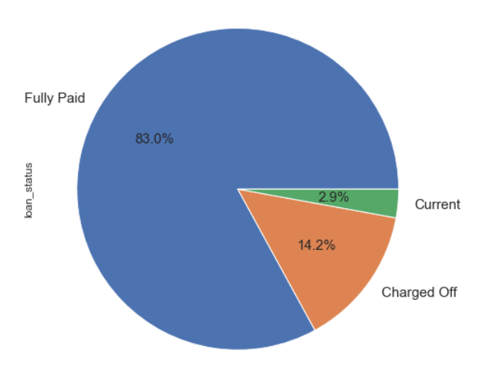
Data Overview
There are 3 types of loans:
Fully Paid (Not Default)
Charged Off (Default)
Current (Excluded from analysis)

Slide 4
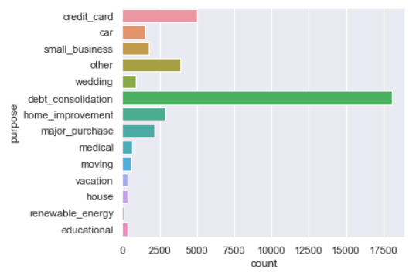
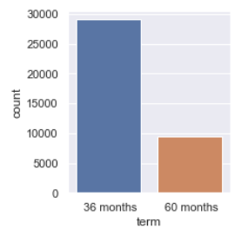
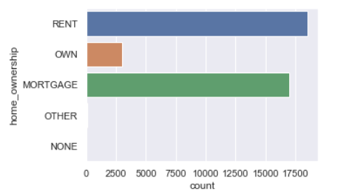
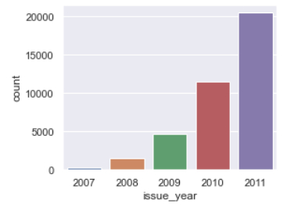
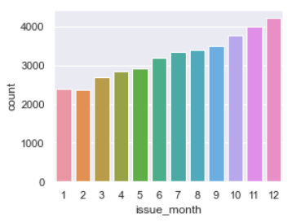
Observations
Most of the loans are of short term (36 months)
Most of the loans are for debt consolidation purpose
Most of the loans are taken by people who live in a rented accomodation or mortaged properties.
Loan count has an increasing trend both month-wise (Jan-Dec) and year-wise (2007-2011)

Slide 5
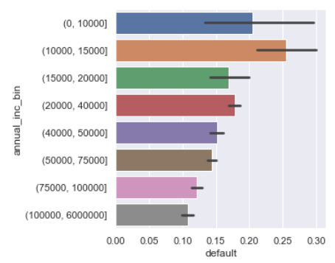
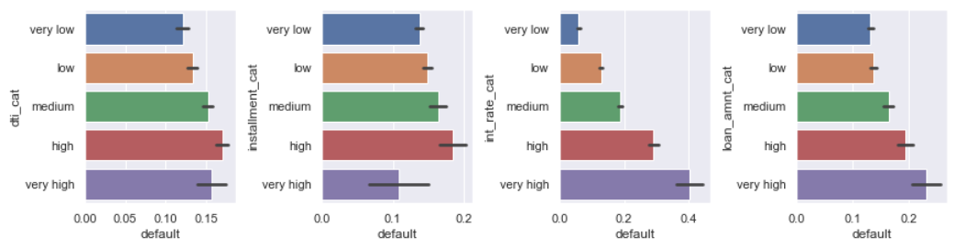
Observations
Higher the annual income, higher the default rate
Borrowers with annual income more than 15000 are less likely to default
Higher the dti (Debt-to-income ratio), higher the default rate
Higher the interest rate, higher the default rate
Higher the loan amount, higher the default rate

Slide 6
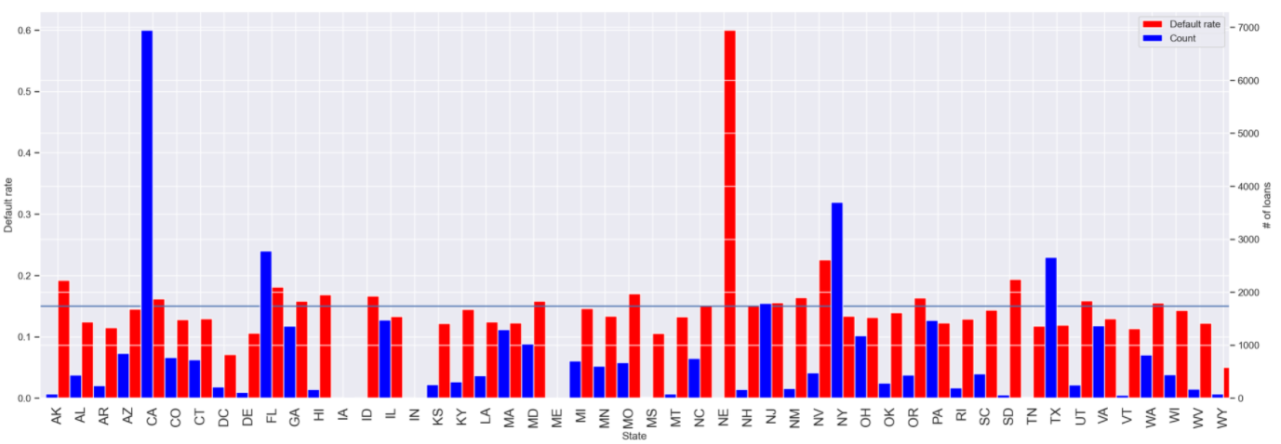
Observations
Most of the borrowers are from states with high population like (CA, NY, NJ, FL): at least 2000 loans. Their default rate is also high (>=15%)
Nebraska have highest default rate but total no. of loans from NE is 5
Nevada also has high default rate

Slide 7
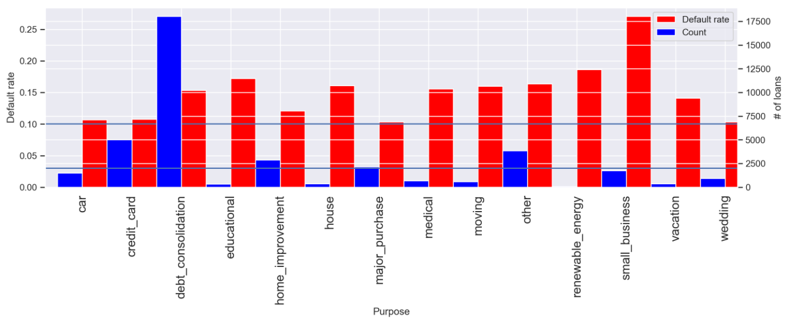
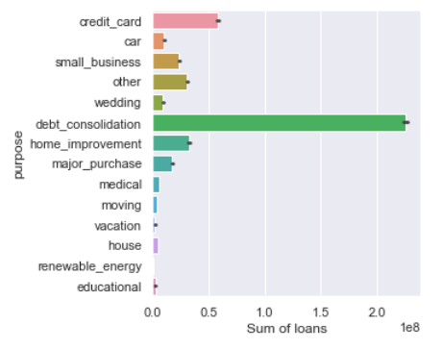
Observations
credit_card, debt_consolidation, home_improvement, major_purchase are the purposes that have more than 2000 count and at least 10% default rate
Most of the money is invested in debt_consolidation and their default rate is also pretty high (above 15%).

Slide 8
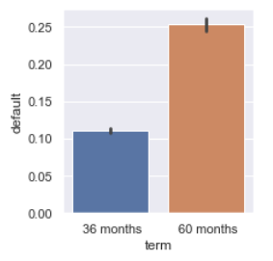
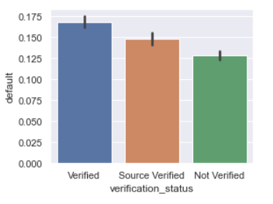
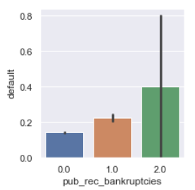
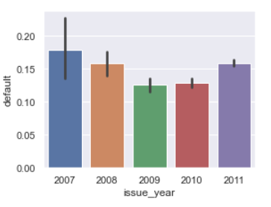
Observations
Loans with term of 60 months are more likely(~15%) to default than loan with term of 36 months.
Verified loans highest default rate followed by Source Verified, with Not Verified loans having least default rate
Borrowers who went bankrupt before are most likely to default. People having 2 records of bankruptcies have a higher probability to default than people with no bankruptcy report
Loans issued in 2009 (After 2007-2008 banking crisis) the default rate decreased probably due to safer lending.

Slide 9
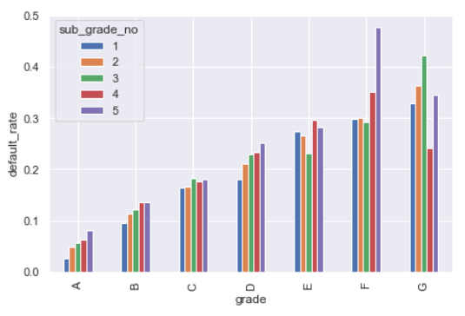
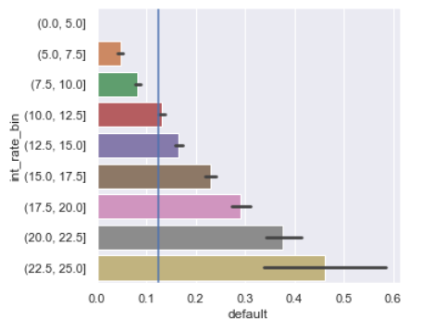
Observations
Default Rate is high for Grade >='C’.
Among them F5 and G3 stands out having default rate over 40%.
A steep increasing trend in default rate can be seen for loans with interest more than 12.5%.
For interest rates greater than 20%, the default rate goes beyond 30%.

Slide 10
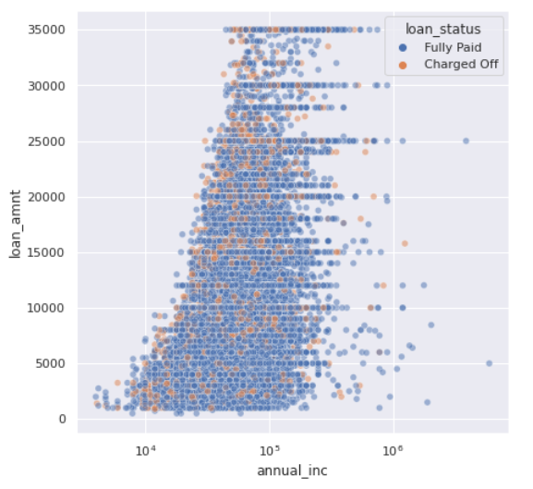
Observations
Borrowers with higher annual_inc go for higher loan amount

Slide 11
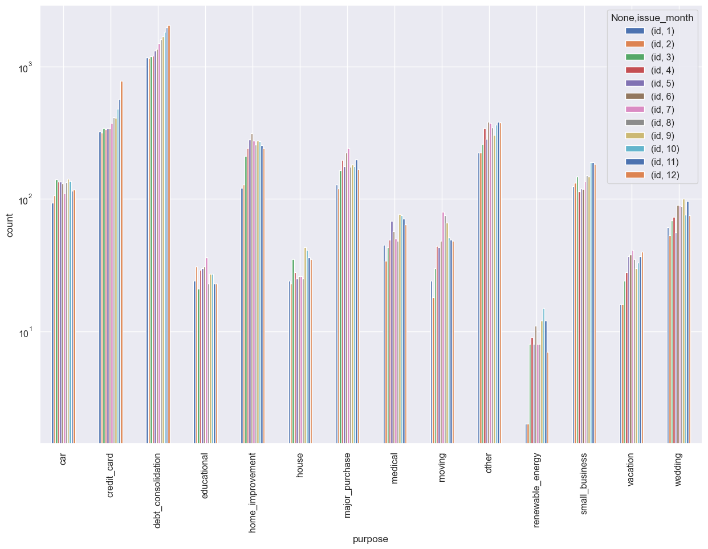
Observations
Interest go higher with the Grades

Slide 12
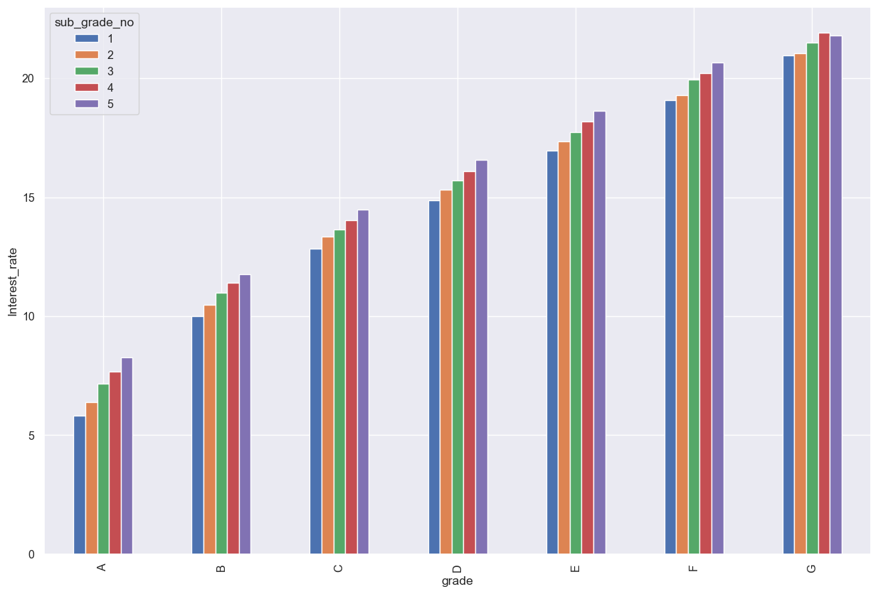
Observations
Safer investments leads to lower default rate as we have
seen in the year of 2009.
Number of loans increase with the month of the year.
Only two of the purpose of the loans can be seen having increasing trend with month which are credit_card & debt_consolidation and these are top 2 reasons for loans.

Slide 13
Recommendations
Stop High Risk Loans
pub_rec_bankruptcy = 2
grade F
int_rate > 20%
Reduce Medium Risk Loans
pub_rec_bankruptcy = 1
state in (FL, NY, NV, CA, TX, NJ)
term = 60 months
Increase Low Risk Loans
pub_rec_bankruptcies = 0
grade 'A'
term = 36 months
purpose = credit card
lesser loan amount
lower dti
annual_inc < 15000
grade > 'C'
int_rate > 12.5%
int_rate 7.5-10%
Our recommendation is to modify the loan approval/grant process based on these factors.

